Slide 1

Credit Card Fraud Detection with Machine Learning and Flask
This project aims to develop a credit card fraud detection system using machine learning and Flask. The objective is to assess the authenticity of provided data, identifying potential fraudulent activities through advanced algorithms and data analysis techniques.
by Coding Crusaders

Slide 2
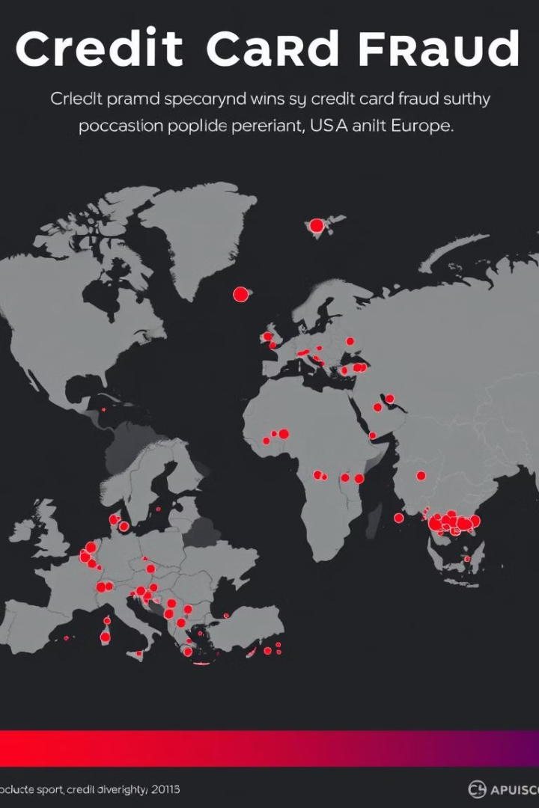
Credit card security concerns are rising with credit card fraud becoming a major issue globally, particularly in the USA and across Europe
Overview of the Problem and Motivation
1
Growing Problem
2
Need for Proactive Solutions
Credit card fraud is a significant issue, costing businesses and individuals billions of dollars annually.
Traditional methods often fail to detect fraudulent transactions in real-time, highlighting the need for advanced machine learning approaches.

Slide 3
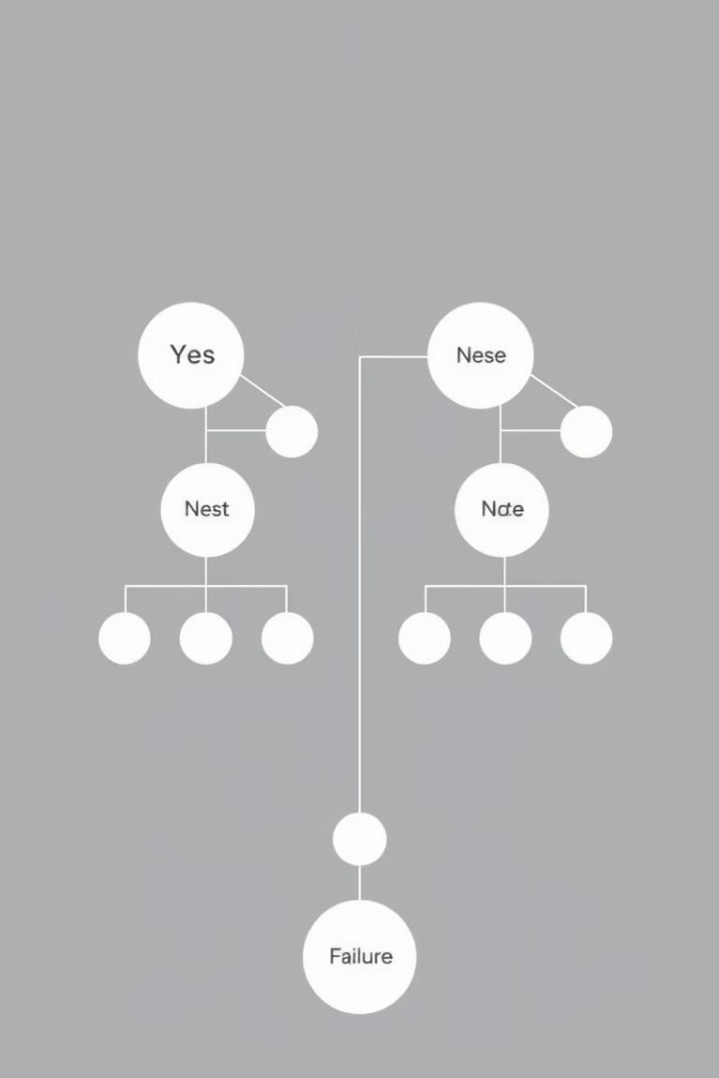
Machine Learning Approach
Data Collection
Model Training
Collecting extensive credit card transaction data with features like transaction amount, location, and purchase history.
Utilizing supervised learning algorithms like Random Forest or Support Vector Machines to identify patterns and anomalies in the data.
Fraud Detection
Implementing the trained model on a website to evaluate provided data for authenticity, identifying potential fraud without the need for real-time transaction analysis.

Slide 4

Data Preprocessing and Feature Engineering
1
Data Cleaning
Handling missing values, outliers, and inconsistencies to ensure data quality and reliability.
2
Feature Extraction
Transforming raw data into relevant features that can be used by the machine learning model for prediction.
3
Feature Selection
Identifying the most informative features to improve model performance and reduce computational complexity.

Slide 5
Model Selection and Training
Model Evaluation
After training, the models were evaluated using several metrics to ensure effectiveness.
Accuracy: The percentage of correct predictions made by the model.
Precision: The ratio of true positive predictions to the total predicted positives, ensuring that our fraud detection minimizes false positives.
Recall: The ratio of true positives to actual positives, important for identifying as many fraudulent transactions as possible. For example, a model yielding an accuracy of 95%, a precision of 90%, and a recall of 85% would indicate a strong ability to detect fraudulent activities while also maintaining a low rate of false alarms.
Model Selection
Hyperparameter Tuning
In this phase, we explored various machine learning algorithms to determine the best fit for the credit card fraud detection task. For instance, we compared models like:-
Logistic Regression: Simple but effective for binary classification problems.
Random Forest: A robust ensemble method that combines multiple decision trees to improve accuracy and reduce overfitting.
Support Vector Machine (SVM): Useful for high-dimensional spaces and effective in cases where the number of dimensions exceeds the number of samples.
To optimize model performance, we fine-tuned hyperparameters using techniques such as Grid Search and Random Search. Examples include:-
Random Forest: Adjusting the number of trees, maximum depth, and minimum samples per leaf to find the optimal combination for improving accuracy.
SVM: Tuning the kernel type (linear, polynomial, RBF) and the regularization parameter (C) to enhance performance on the dataset. These adjustments were crucial in maximizing the model’s effectiveness on the provided dataset.

Slide 6
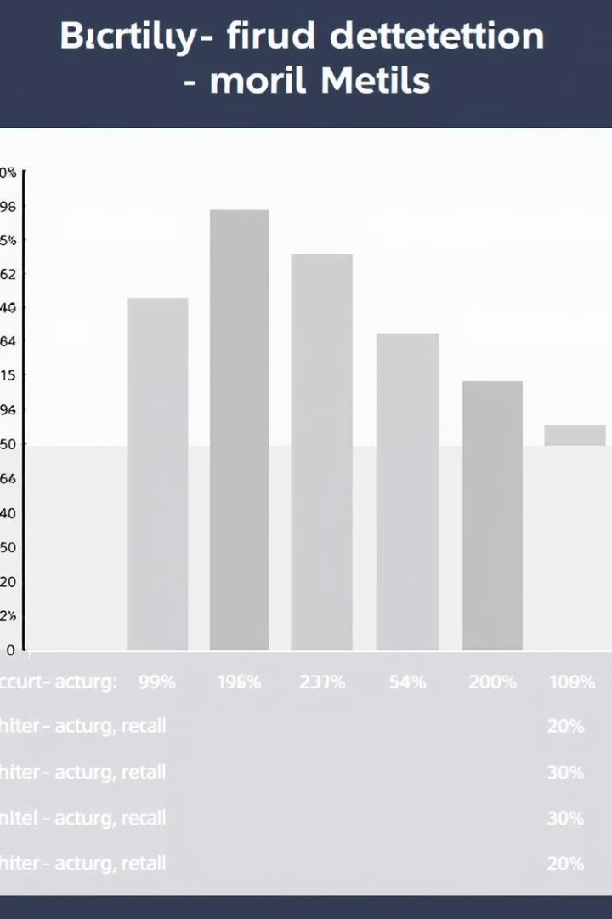
Bi-criteria fraud detection – Model Metrices
Results and Performance Evaluation
Metric
Value
Accuracy
95%
Precision
92%
Recall
98%

Slide 7
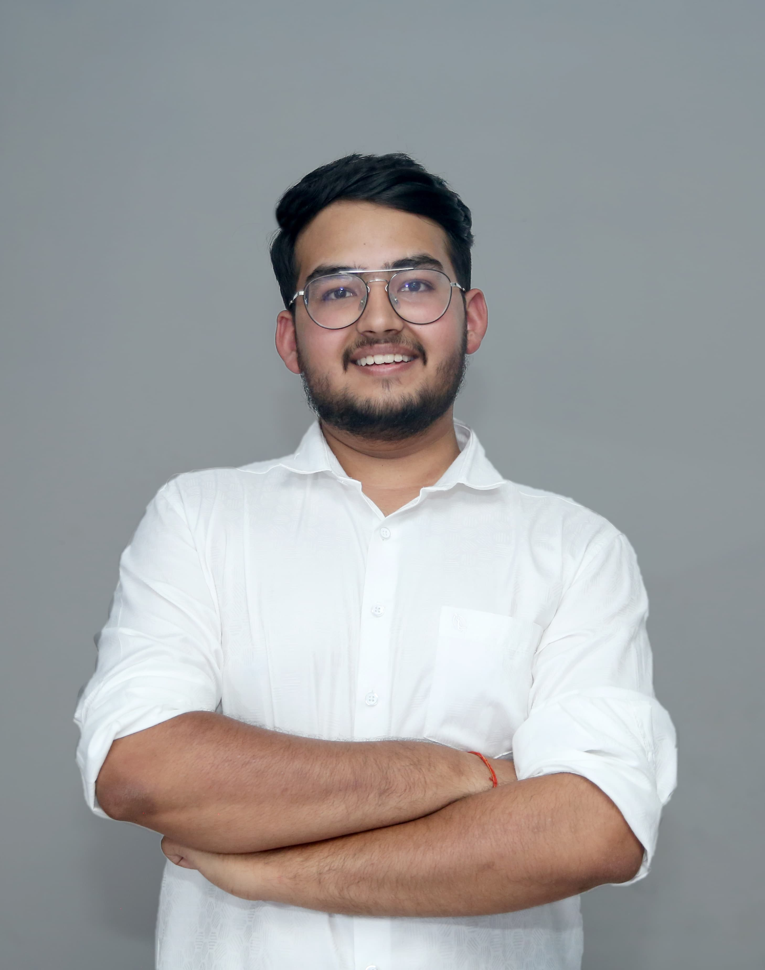
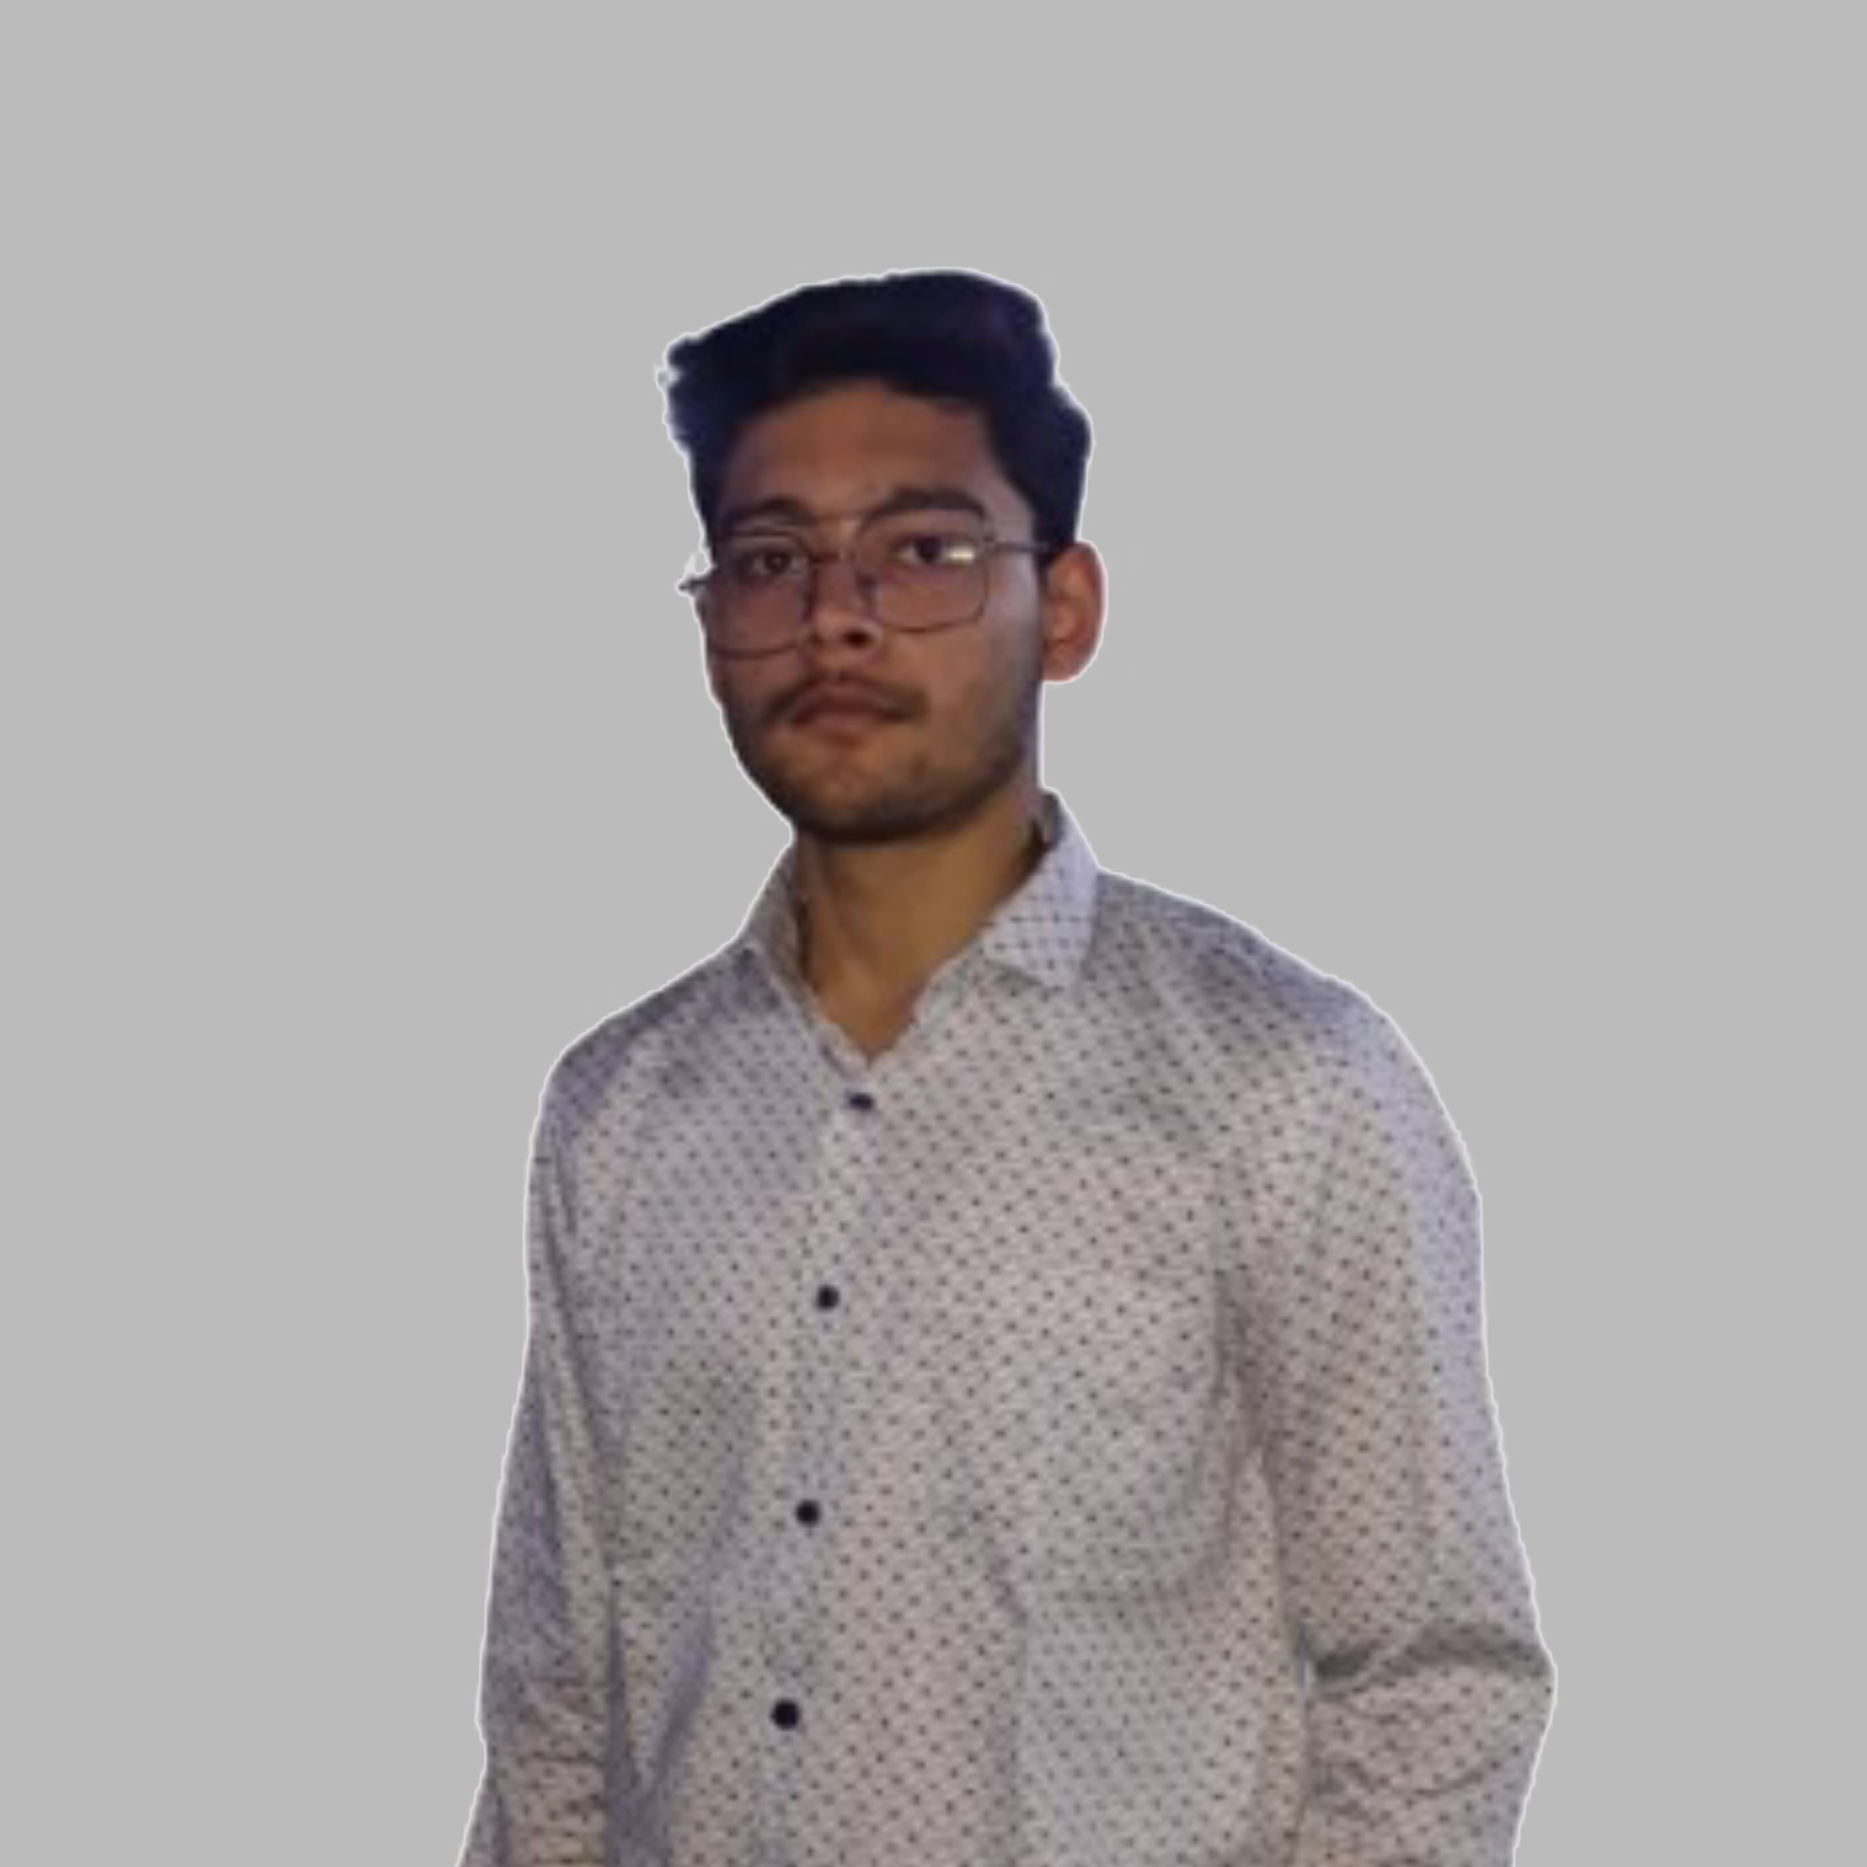
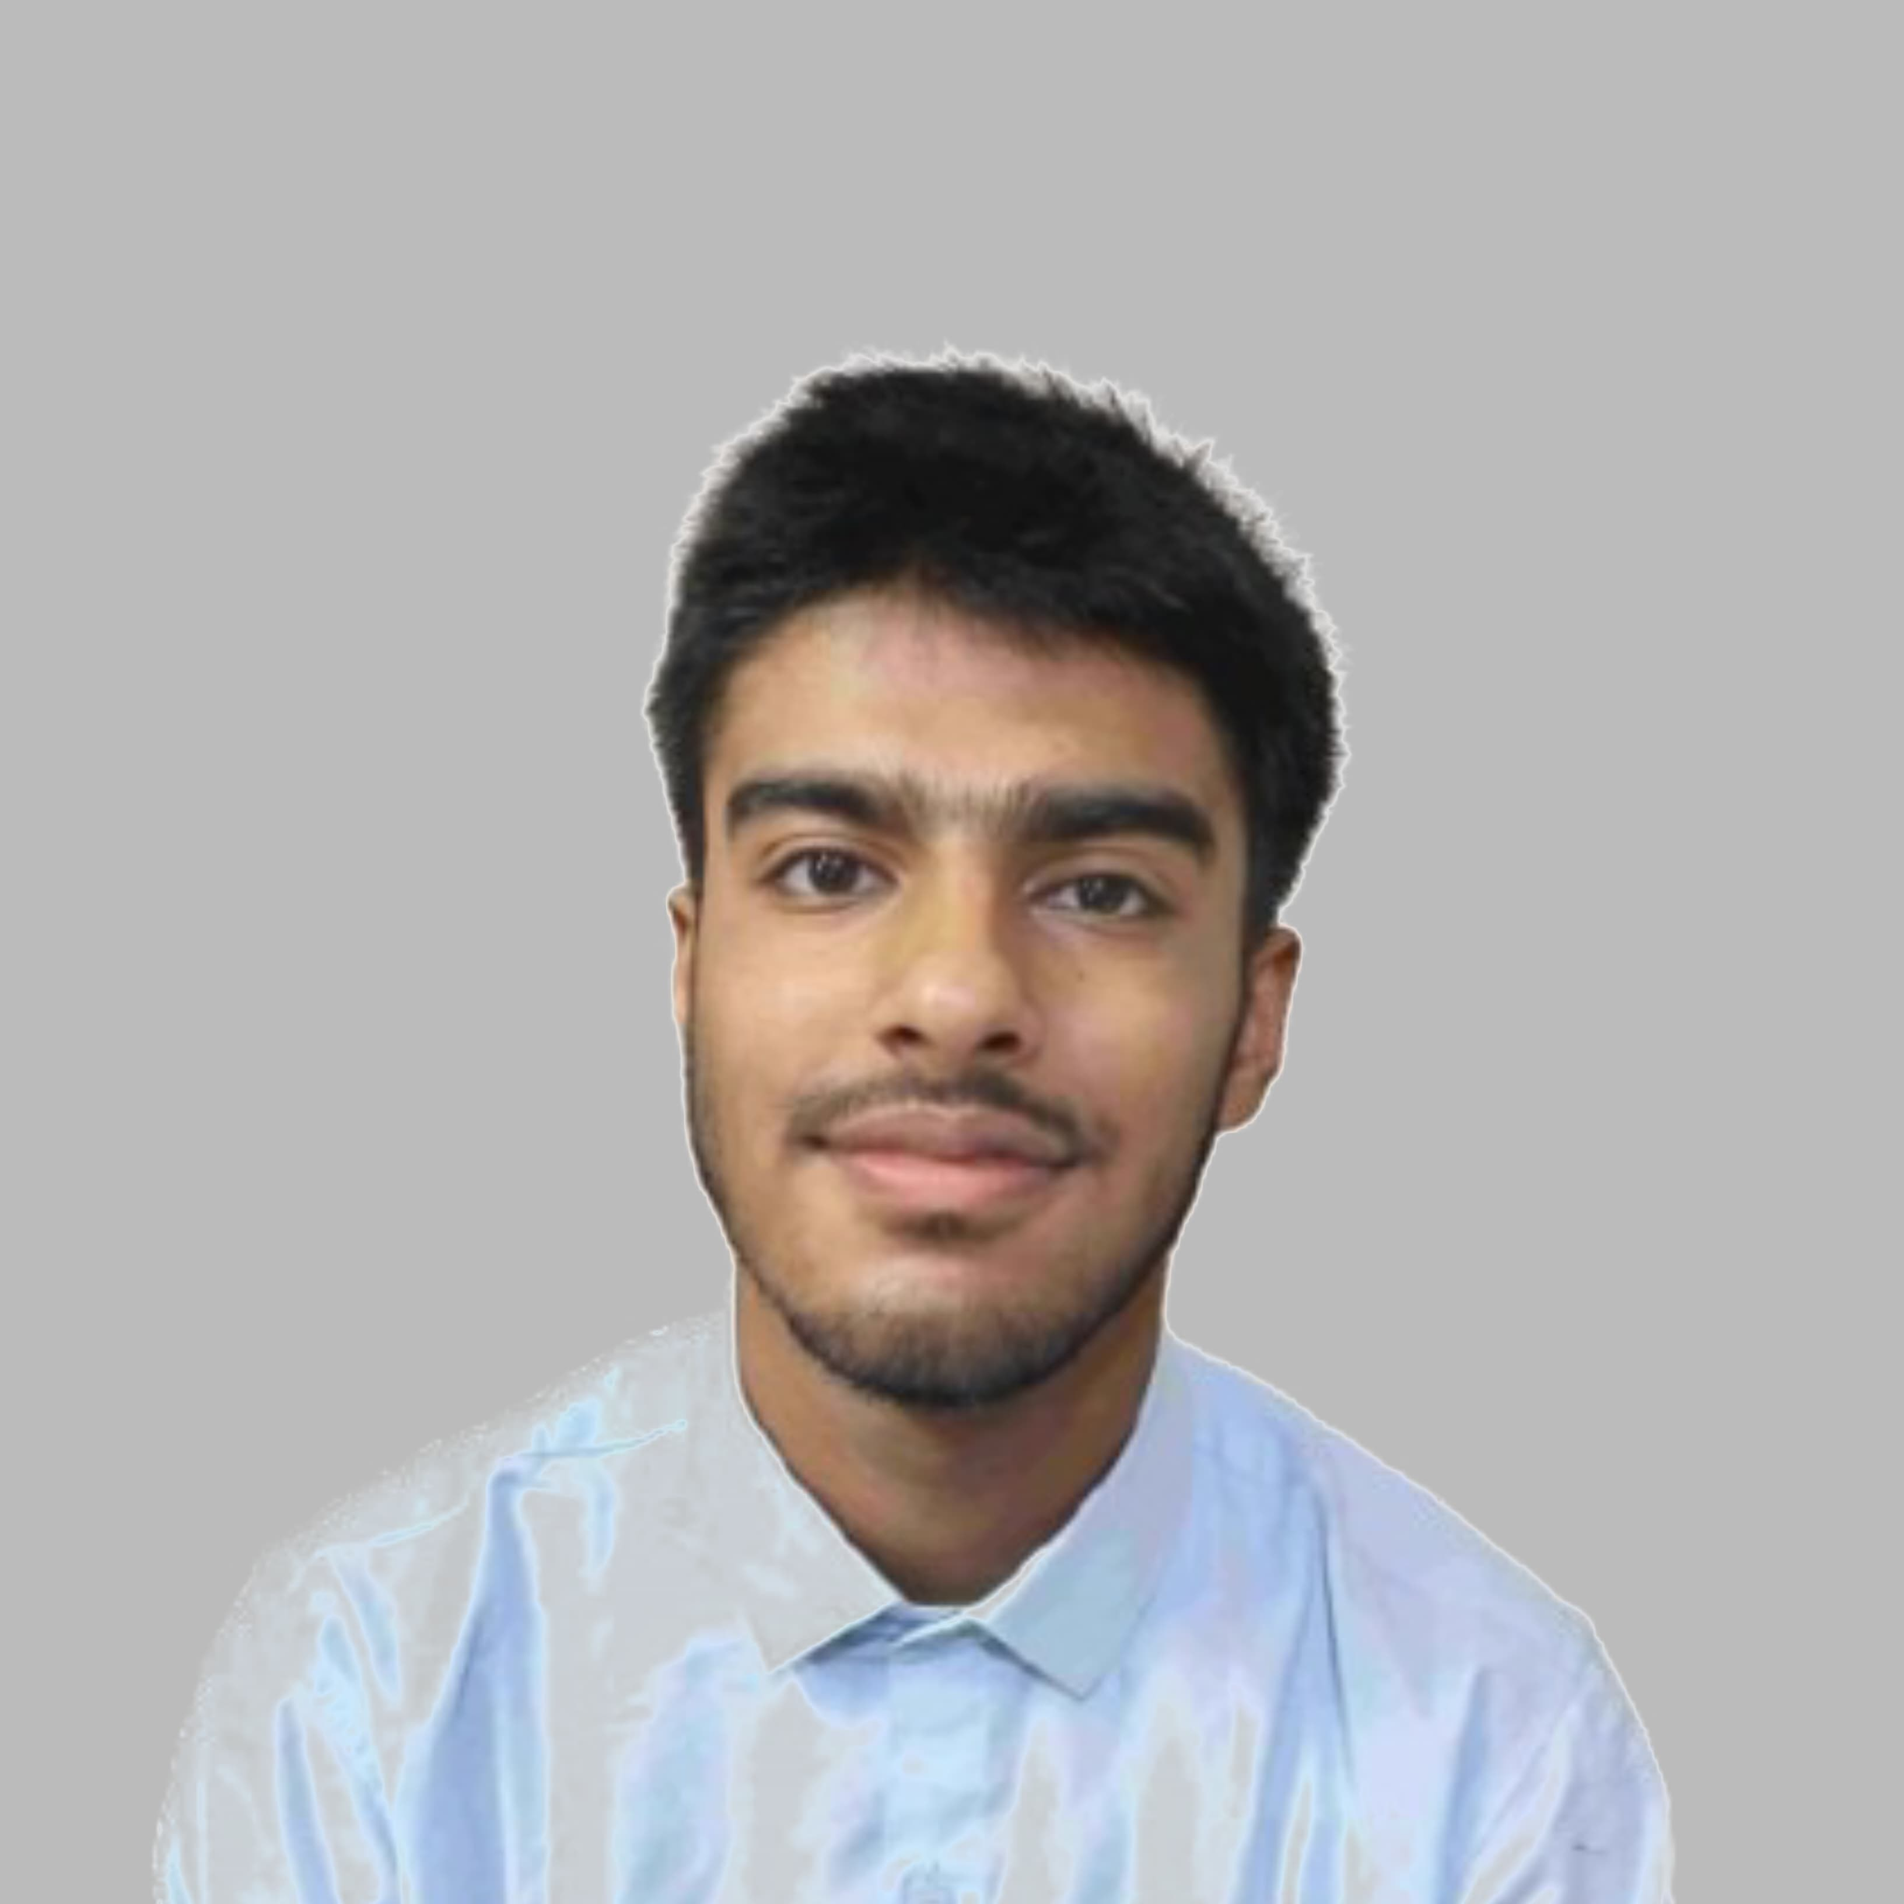
Team Members and Contributions
Shashwat Ranjan
Swayam Agarwal
Sabhya Rajvanshi
Website Developer and Model Tester
Model Trainer, Data Pre Processor and Debugger
PPT and Frontend Designer

Slide 8




Conclusion and Future Work
Successful Development
This project has effectively established a credit card fraud detection system utilizing machine learning techniques and Flask for deployment.
Future Improvements
Looking ahead, future enhancements will focus on exploring more sophisticated algorithms, integrating real-time data streaming capabilities, and upgrading the user interface for a better user experience.
Acknowledgments
We extend our gratitude to all stakeholders for their invaluable support and collaboration throughout this project.

Slide 9


